Slide 1
System and Network Administration
Boot Disk

Slide 2
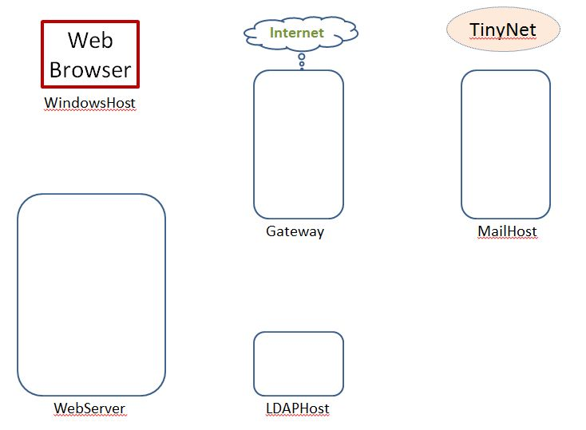
Getting Started
TinyNet
Comes in two parts
Base.iso (base image)
Config.iso (configuration and applications)
Create a virtual machine
Partition the disk
Create a filesystem
Copy the OS
Install the bootloader
Configure common services
Clone!
After installing VirtualBox, create VMs!
www.my-tiny.net

Slide 3


Slide 4
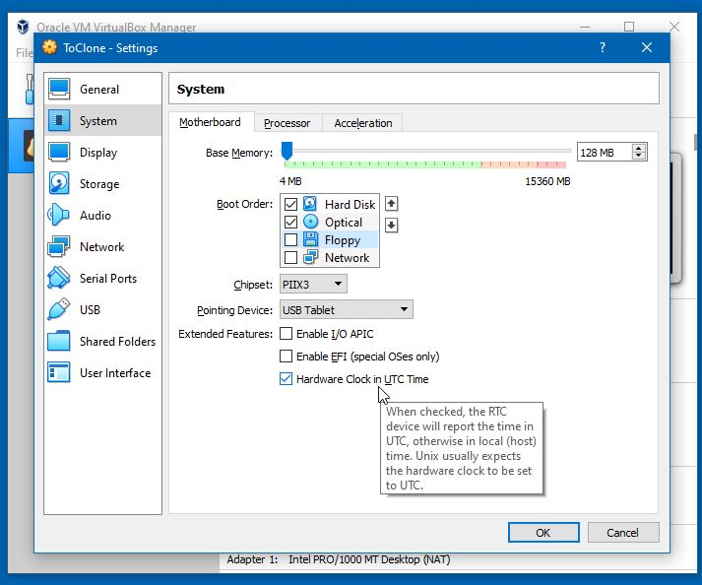

Let’s get the boot order right first, so we only boot from the CDROM when we cannot boot from the hard disk - Has anyone seen a floppy disk lately ??
Leave the time in UTC (GMT) –file timestamps may look funny but it works better

Slide 5
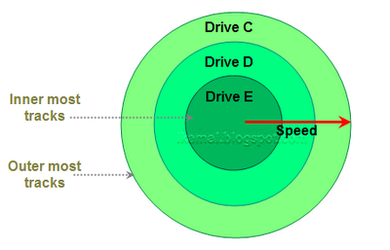
Disk Partition
A partition separates a disk into logical “drives”
A “DOS” (32-bit OS) partition can be one of two types:
Primary : can hold information regarding the operating system which is required for booting.
Extended: only for data files

Slide 6
Disk partitioning: fdisk
Reserve space for a particular function swap space, software, user directories, shares
Each partition is given a logical device name C:\ D:\ E:\ etc
/dev/sda1 /dev/dsk/c0t0d0s0
Each partition can use a different file system
Logical volumes seamlessly span multiple partitions
Use different partitions when
They have different functions
They are owned/maintained differently
They change at different rates
Backup policy is different for each
Notes:
Network Administration - Managing Hosts and Users
11/23/2021
6
Swap space as a separate partition is fairly typical
Separate partitions for different groups of files makes sense
Some groups of files need frequent backups
Some groups of files rarely change, infrequent backups

Slide 7
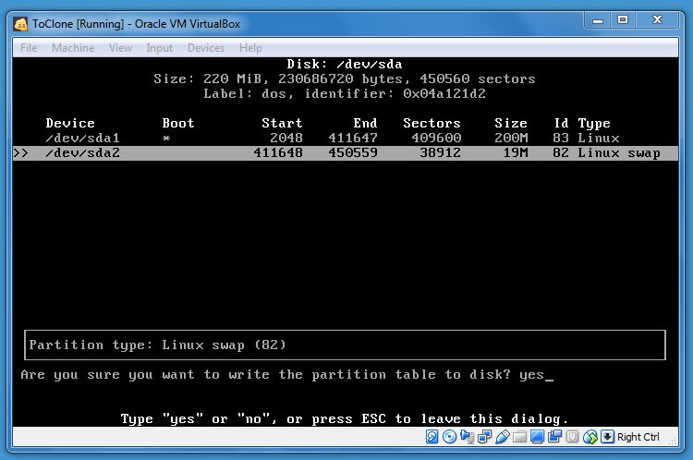
You have to type yes (not just y) to write the partition table; don’t worry about any warnings, they are for people with “non-virtual” hard disks.

Slide 8




Slide 9
File Systems
Structures disk area for addressable access
“like painting car spaces in a carpark”
Usually unique to OS
windows: FAT, FAT32, NTFS
linux: ext2, ext4,
linux is one huge computer science project!
Physical sectors grouped into allocation units called blocks in Unix and clusters in Windows
Building File System - mkfs or format
boot sector, data area, free list
Notes:
Network Administration - Managing Hosts and Users
11/23/2021
9
Mostly we only need to do
High level formas (like painting or repainting the lines in car spaces..)
Or zero-filling (scouring the carpark of any marking)
Low level format requires great accuracy, and so must be avoided
Some filesystem formats are interoperable, e.g., FAT32, ISO9660 (although the latter is not for hard disks)

Slide 10
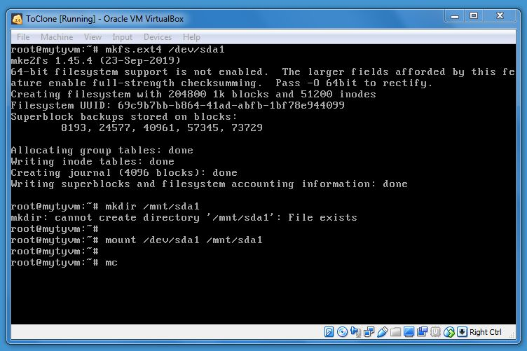
mkfs.ext4 /dev/sda1
mkdir /mnt/sda1
mount /dev/sda1 /mnt/sda1
Create a filesystem on the data partition
Make sure the mountpoint exists
Make the device available to the OS through the mountpoint in the filesystem
Then start mc – our favorite linux file manager

Slide 11
Windows File Systems
FAT32
Maximum file size 4 GB Max partition size 2 TB
Provides only Folder-level security
3 permissions: Read, Change, Full Control
NTFS
Supports Exabyte size files and partitions
File-level and Folder-level security
6 standard plus “advanced” permission combinations
Data compression support
Encrypted File System support
Disk quota management
FAT32 is common on USB drives

Slide 12
Linux File Systems
File system | Maximum filename length | MBR | Allowable characters in directory entries | Maximum pathname length | Maximum file size | Maximum volume size
ext3 | 255 bytes | 0x83 | Any byte except NUL and / | No limit defined | 2 TB | 32 TB
ext4 | 255 bytes | 0x83 | Any byte except NUL and / | No limit defined | 16 TB | 1 EB
Most of the Linux is using ext* family

Slide 13
Swap Space
Swapping frees RAM by storing an image of an idle process on disc - few modern OSs actually do swapping
The swap file is now used for paging – virtual memory stored on disc
In Unix the swap file is traditionally a partition
In Windows the swap file is always a file
Recommended size 2.5 * RAM
Any more will probably never be used
Notes:
Network Administration - Managing Hosts and Users
11/23/2021
13

Slide 14
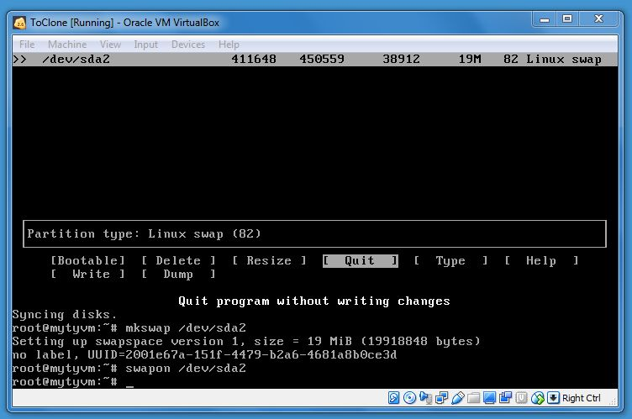
mkswap /dev/sda2
swapon /dev/sda2
Create a filesystem the swap partition and activate it
The swap filesystem just shows it’s registration number
Swap is basically invisible – the OS takes care of it internally

Slide 15
Mounting Disks / Partitions
Naming conventions for devices
Disk: /dev/sda /dev/sda1 … (usb will be recognised as this)
CD/USB: /dev/sr0 …
mount /dev/sda1 /mnt/sda1
access everything on the drive through the directory instructions in /etc/fstab
umount /mnt/hostshare
cannot unmount a busy filesystem
show open files on a filesystem: lsof

Slide 16
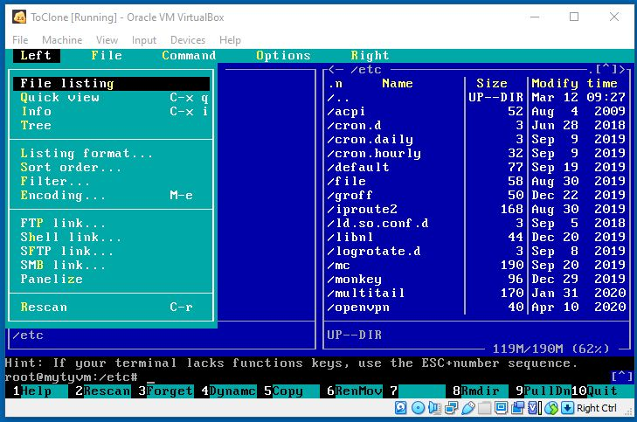
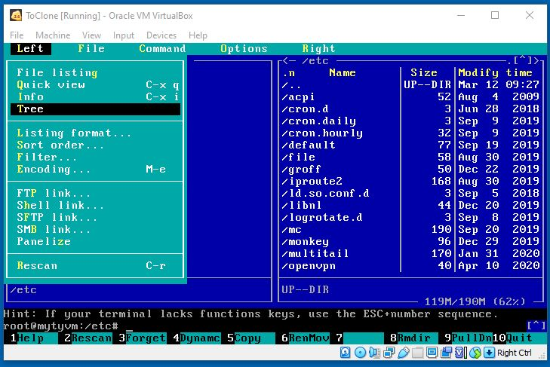
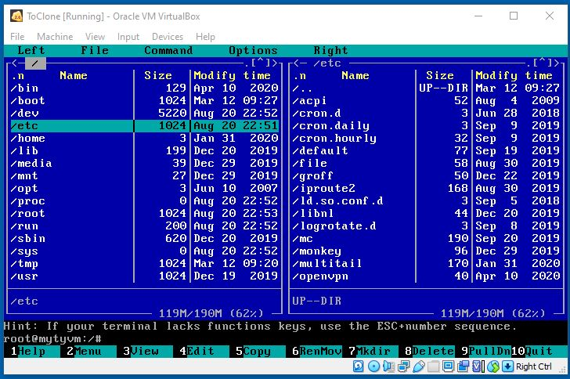
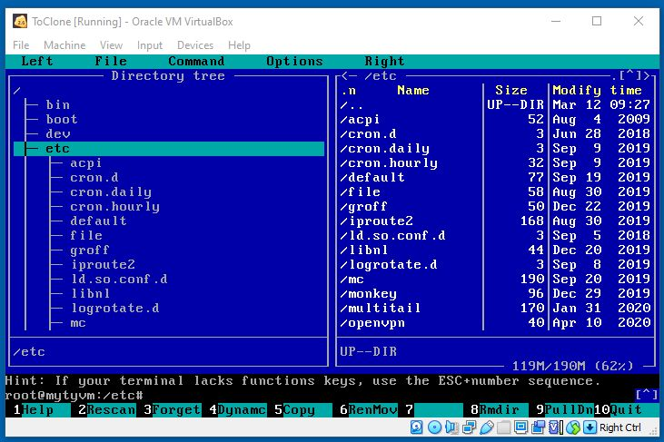
Press [F9] for the mc menu
Two directories
Tree and directory
Press [Tab] to switch sides

Slide 17
Paths
/ root directory . here .. up one level
/tmp/foo absolute tmp/foo relative ../../foo
cd change directory mv move or rename
cd /etc
cd foo
cd ..
mv foo ofo rename
mv ofo /var/opt move
cd /var/opt/ofo
./myscript.sh execute a file stored here

Slide 19
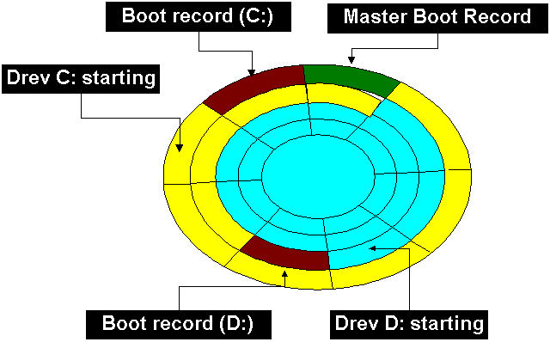
Master Boot Record
The master boot record (MBR) is the first sector of a hard disk
It includes a table that contains information about each partition
The diagram shows a disk with two primary partitions
The MBR also includes a program that reads the boot sector record of the partition containing the operating system into RAM.

Slide 20
Multiple Operating Systems – Boot Managers
With multi-use machines and big disks it is possible to have several different OSs
Each OS has its own boot manager in the MBR
Some are generalised, some not
For example, Windows relies on files accessed from drive C:
so install Windows first, then install Linux
Unix loaders:
LILO (LInux LOader),
syslinux (common for iso)
GRUB (GRand Unified Bootloader)
Notes:
Network Administration - Managing Hosts and Users
11/23/2021
20
Virtualization, e.g., with VMware, negates the need for multiple boots in a host.
But virtualization is not perfect, e.g., compatibility issues, and taxes the hardware with multiple concurrently running Oss.

Slide 21
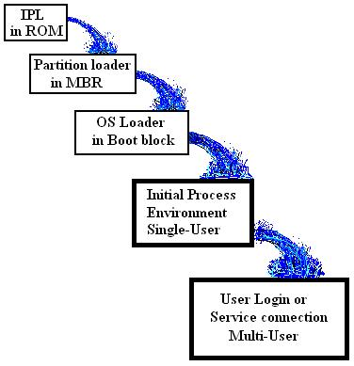
PC Bootstrap Sequence -- An Avalanche boot
BIOS IPL loads MBR
MBR selects active partition, loads partition boot
Partition boot loads OS loader
OS loader loads kernel
Kernel initialisation loads initial process
Initial process spawns user-level processes
IPL: Initial Program Loader
MBR: Master Boot Record
Notes:
Network Administration - Managing Hosts and Users
11/23/2021
21
These details matter for fault isolation.

Slide 22
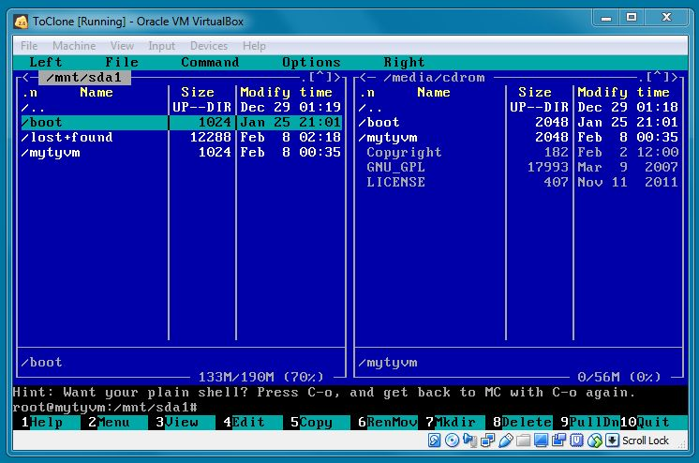
Painless Install!
Final step is to install the boot loader – BE SURE you are on the /mnt/sda1 side

Slide 23
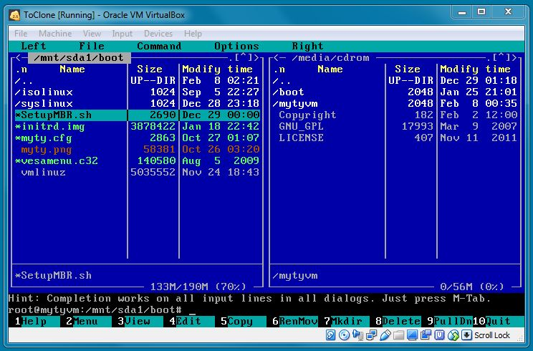
Move into /boot
Highlight SetupMBR.sh and press [enter]

Slide 24


